Slide 1
GSECARS Update
COMPRES Annual Meeting
July 10, 2017

Slide 2
Facilities and Techniques

Slide 3
Beamtime Requests and Subscription Rates
1,926 first choice beamtime requests were submitted for 2013 to 2017-2.
138 beamtime requests per APS run cycle
34 requests per beamline per cycle
Diamond Anvil Cell received most proposals followed by X-ray Microprobe and Large Volume Press.
Subscription rate averages past 5 years:
2.8 for insertion device beamlines
1.2 for bending magnet beamlines
13-BM-C subscription has increased significantly with PX^2 program on 13-BM-C.
More than 70% of proposals eventually receive time because we award fewer shifts than requested and proposal scores are incremented if not awarded beamtime.

Slide 4
2017-2 Beamtime Requests
Station | Technique | Beamtime requests | Shifts requested | % available shifts
13-ID-D | Diamond cell | 52 | 335 | 169%
13-ID-D | 1000-ton press | 8 | 96 | 48%
13-ID-C | Paris-Edinburgh cell | 2 | 18 | 9%
13-ID-C | Surface scattering | 4 | 32 | 16%
13-ID-C/D | Total | 66 | 481 | 243%
13-ID-E | Microprobe (Total) | 36 | 315 | 159%
13-BM-D | Diamond cell (Brillouin) | 8 | 99 | 50%
13-BM-D | 250-ton press | 6 | 73 | 37%
13-BM-D | Microtomography | 10 | 60 | 30%
13-BM-D | Total | 24 | 232 | 117%
13-BM-C | Diamond cell (single-crystal, PX^2) | 23 | 200 | 100%
13-BM-C | Other | 2 | 27 | 14%
13-BM-C | Total | 25 | 227 | 114%

Slide 5
GSECARS Funding - The Good News
GSECARS funding has traditionally been ~75% NSF-EAR-IF (same program as COMPRES) and 25% DOE Geosciences
Submitted renewal proposals on February 12, 2016.
Same proposal to each agency, but with separate budgets (NSF XXXM, DOE XXXM)
Site visit was held on May 18, 2016
NSF is funding GSECARS at requested level (average of $XXX/year)
Changed from a grant to a Cooperative Agreement like COMPRES
Award period began February 5, 2017

Slide 6
GSECARS Funding- The Bad News DOE Geosciences has decided to terminate funding for GSECARS
Science and facility were judged to be excellent
Justification for termination was that the directly funded PIs in that program did not use 25% of the GSECARS beamtime
However, such science funded by other agencies does use >25%
In fact it was a decision from higher up in DOE-BES to discontinue funding for facilities from the DOE science programs
HP-CAT is similarly losing its BES Materials Science support
Awarded $700K per year for 2 years (compared to ~$1M per year for 5 years requested).
Ends on August 15, 2018.

Slide 7
GSECARS Alternative Funding
DOE-BES has effectively reduced support for APS beamlines by $1M/year with this decision
GSECARS is viewed as one of the most successful sectors by APS and BES management.
BES Facilities program should help to support us, but they do not make grants to universities, they only provide funds to the facilities (APS, NSLS-II, etc.) directly.
Have just submitted a plan to have APS contribute ~$500K/year to GSECARS, based on the contributions we make to the facility as a whole:
Software (Mark Rivers, Matt Newville); optics (Peter Eng)
Unclear if APS budget will be increased at all to help with this, so it may be difficult

Slide 8
GSECARS Alternative Funding
Have submitted a NASA proposal
“Development of XAFS and XRD Methods Applicable to Picogram Samples Returned by NASA Missions”
3 years, ~$215K/year
Plan to submit a proposal to Jim Rustad’s program for pink-beam tomography development.

Slide 9
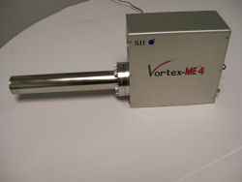
Equipment Upgrades Previous NSF award received ~$400K supplement for detector acquisition
Vortex ME7 7-element silicon drift diode detector for high-count rate XRF and spectroscopy on 13-ID-E microprobe. Upgrade Xspress3 electronics from 4 to 7 channels.
20M counts/second total count rate
1 ms per spectrum for fast mapping
Pilatus3 X CdTe 300K-W detector (1475x195 pixels)
Amorphous diffraction in Paris-Edinburgh cell with Soller slits
Can be scanned to provide large area coverage in some applications
Should both be available in 2018-1.

Slide 10
APS Beamline Enhancement Funding for APS-Upgrade
GSECARS submitted 4 proposals to APS for funding to upgrade our 4 beamlines as part of the APS Upgrade Project.
The following were rated Highest Priority, meaning they will be funded.
These are mostly to upgrade mirrors to much smaller slope error, and to improve monochromator stability.
Timescale of funding unknown at present, probably no sooner than 2020?
13-ID-E microprobe station:
Replace dual horizontal focusing mirrors in first-optics enclosure
Two new sets of K/B mirrors in end station for sub-micron focus on sample
Upgrade double-crystal monochromator in first-optics enclosure
End-station instrumentation
13-ID-D high-pressure station:
New 350 mm K/B mirrors for sub-micron focus in diamond-cell experiments
5 other items on 13-ID-C/D were rated High Priority meaning they may be funded if sufficient contingency funds remain in the project near completion.
Bending magnet items were all deferred because the APS-U project has not decided what, if anything, to invest in bending magnet beamlines

Slide 11
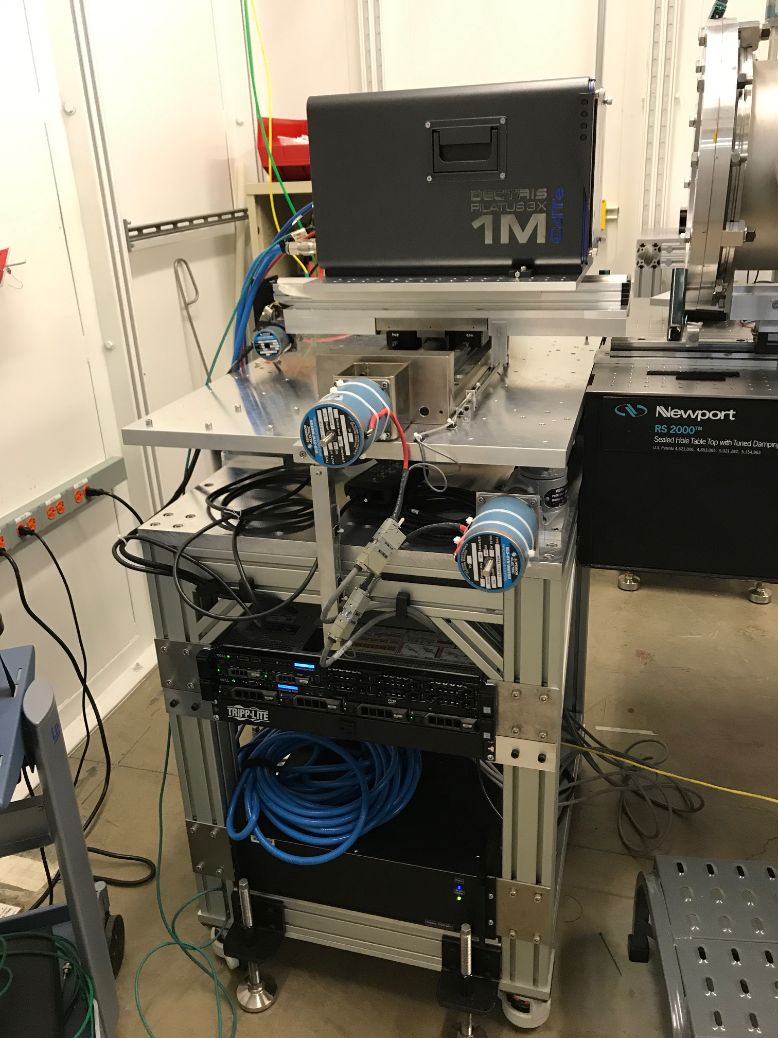
Pilatus3 X 1M CdTe Detector
2015 NSF-MRI award jointly to GSECARS and ChemMatCARS
Pixel-array detector with excellent high-energy sensitivity
Up to 500 frames/s, gateable down to 100 ns.
$700,000 detector cost plus $15,000 for a support stand
Available for users since 2016-3 APS run cycle (almost 1 year)
We have offered either marCCD or Pilatus3 to users, but virtually all users have selected the Pilatus3.
Available 40% of the time to GSECARS, which is ~2 weeks less than DAC run in 13-ID-D, so some users must still use marCCD.
Pilatus3 300K will be used for P-E cell experiments.
Will reduce time users cannot use Pilatus3 1M
Detector has enabled new science (next slides)

Slide 12
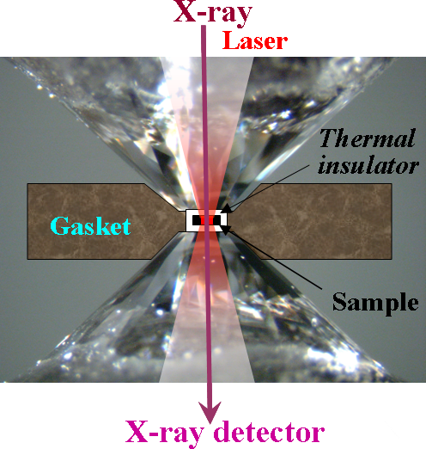
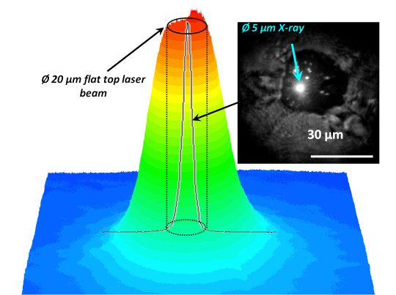
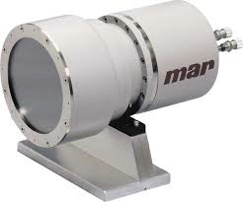
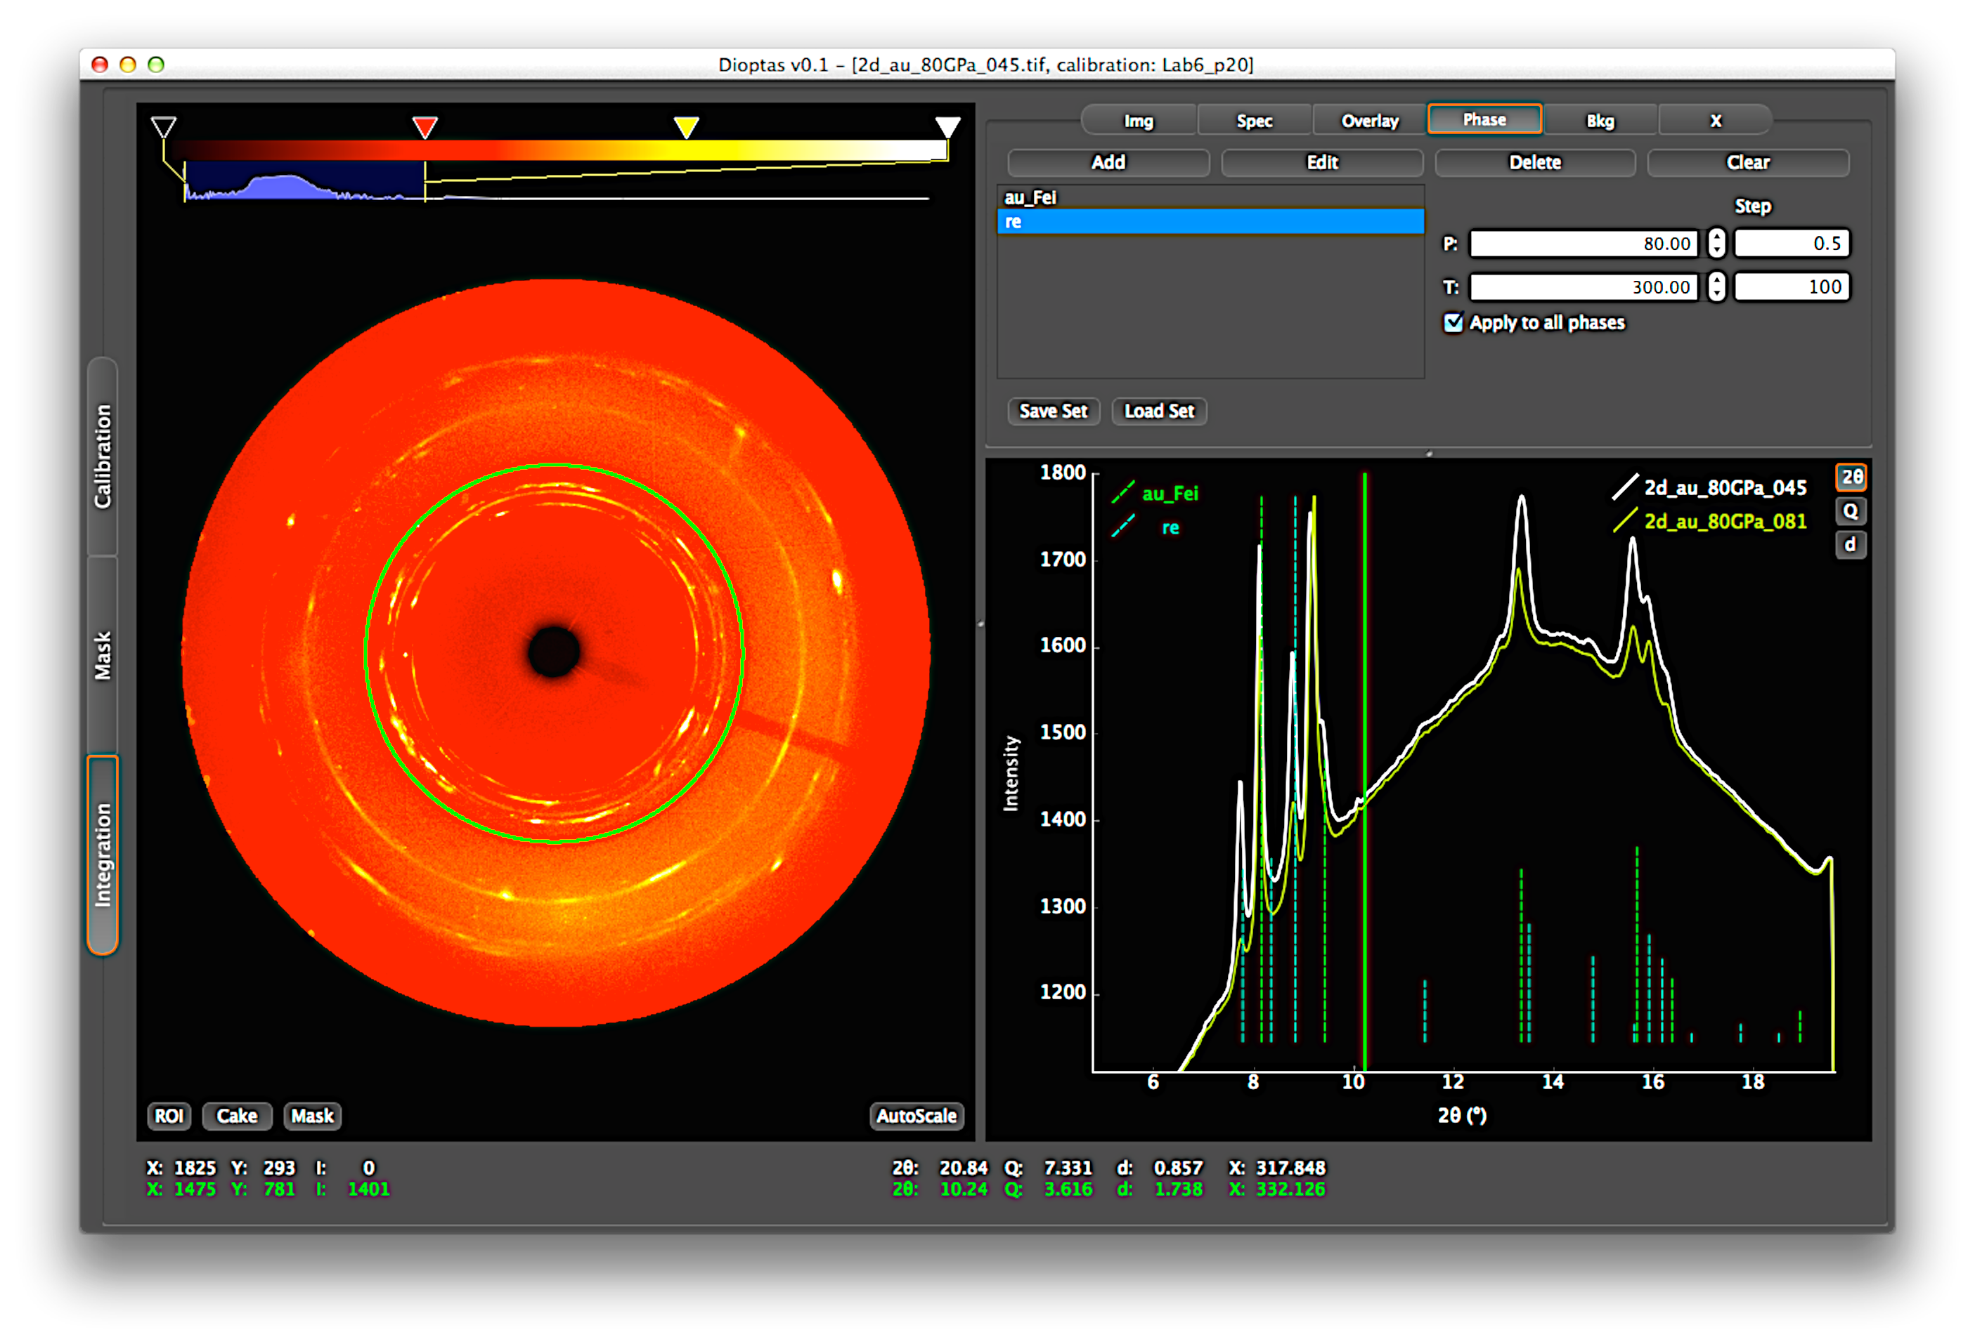
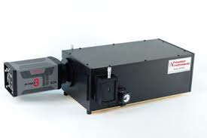
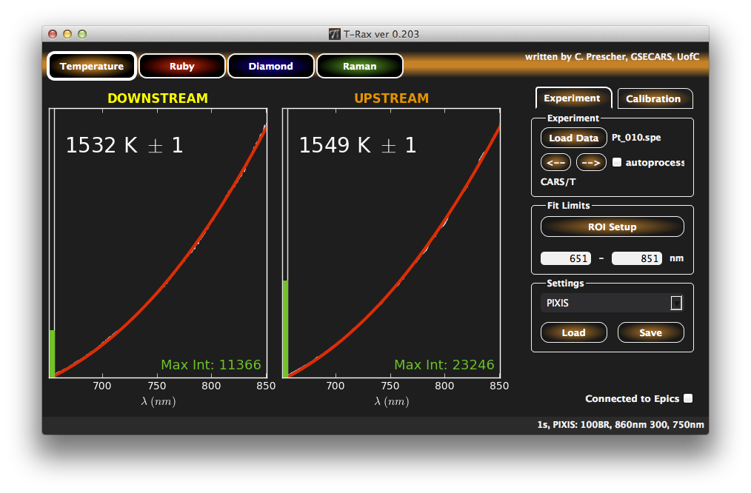
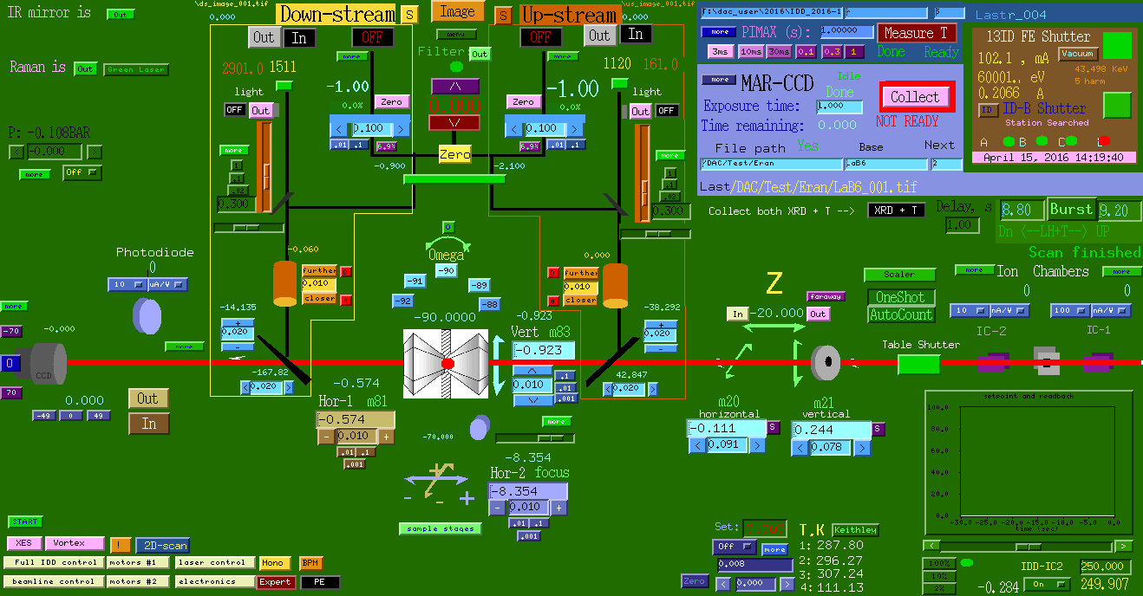
Burst laser heating & XRD
Precise alignment of sample image
with five optical axes:
x-ray(1), lasers(2) and spectroscopy(2)
start
Laser ON (0.2s – 10s)
stop
delay
power
calculate T
→ integrate XRD
→ RT XRD
→ update log-file
Laser
X-ray detector ON
no user interaction
CdTe
exposure
Detector
T measurements ON
exposure
Temerature
EPICS control
Notes:
To encourage young scientist to do challenging experiments, very efficient

Slide 13
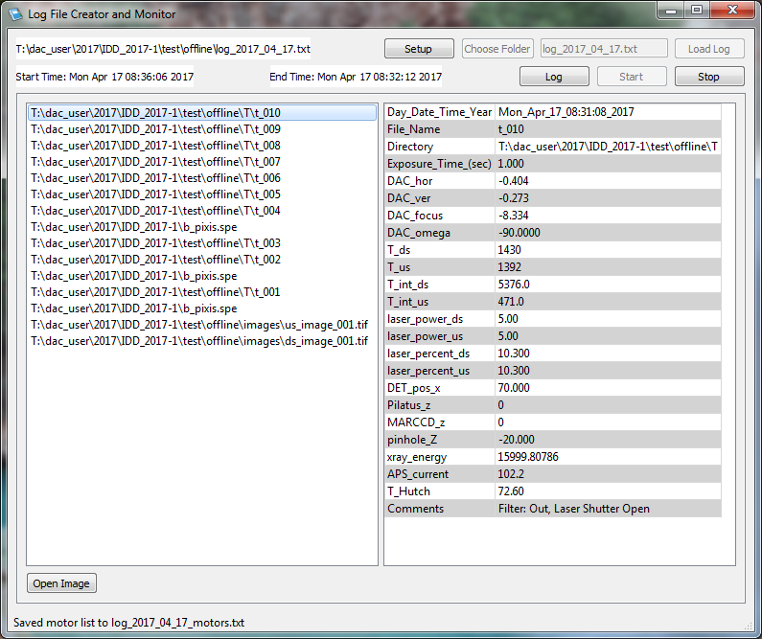
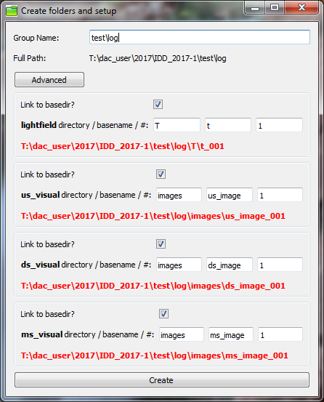
Log-file
Eran Greenberg, GSECARS
Notes:
Logfile can be opened offline with the LogFile software.
The logfile is also saved in a format easily imported as a spreadsheet.
It is possible to decide which PVs are recorder (and whether they are recorder at the start of collection (black) or at the end (blue).

Slide 14
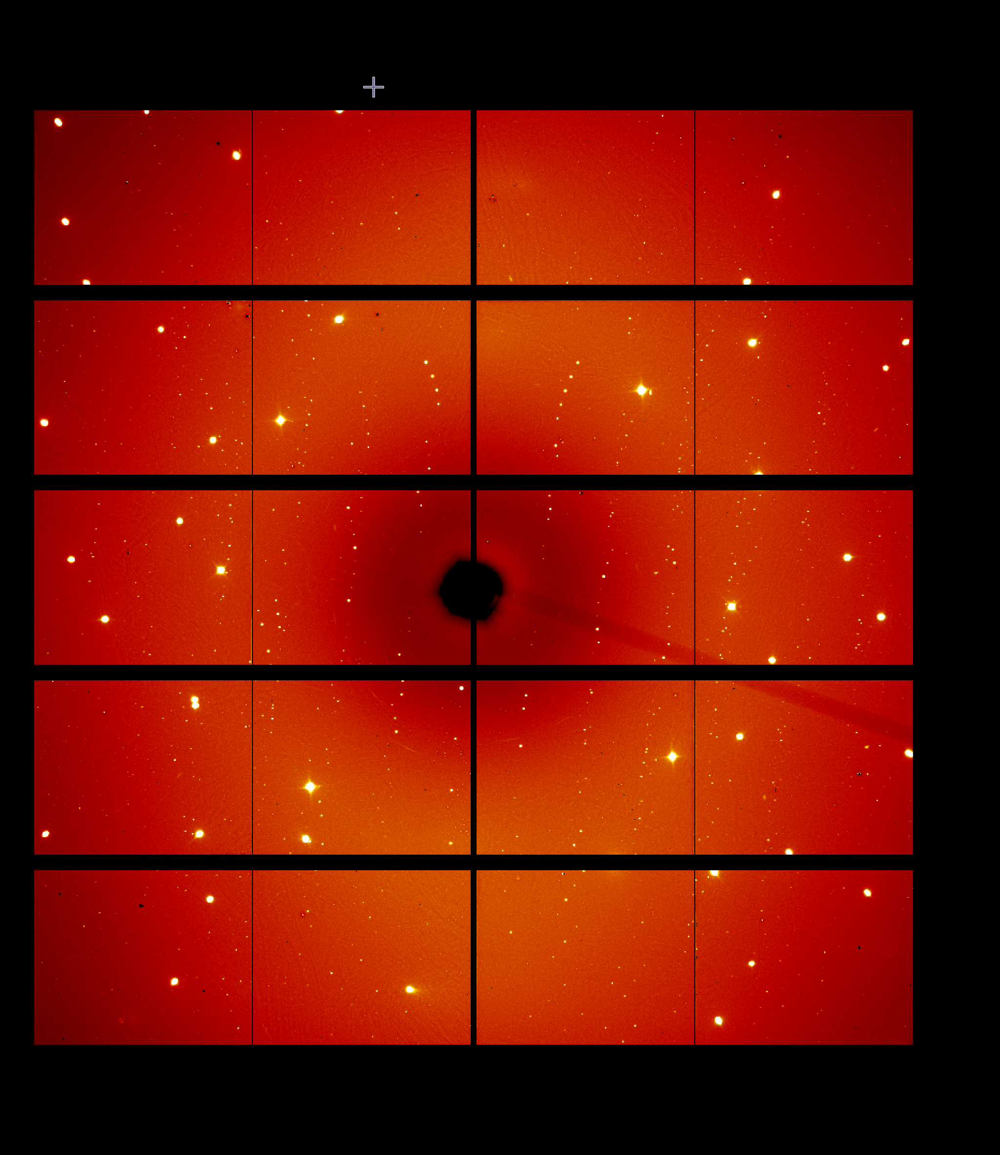
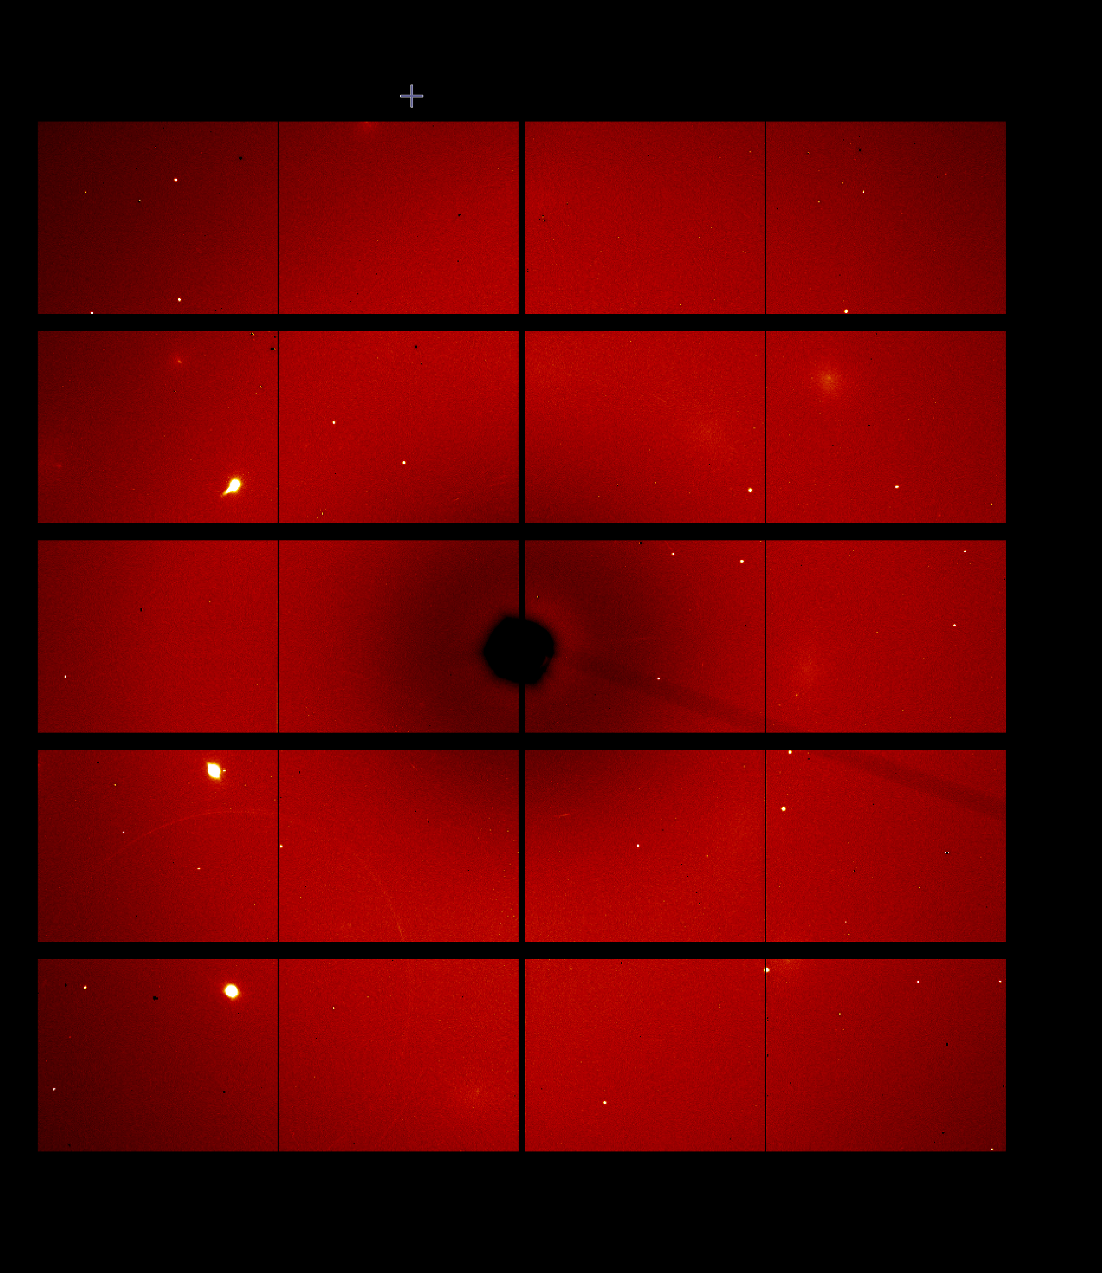
Fast high pressure single crystal measurements
Sample rotation
Wide scan
X-ray
beam
+/-33 degrees, 0.5” step, 0.2s exposure, 133 files => 27s
Step scan
Log file from Newport XPS
File | STX.CurrentPosition | STX.FollowingError | STX.SetpointPosition | STX.CurrentVelocity | STZ.CurrentPosition | STZ.FollowingError | STZ.SetpointPosition | STZ.CurrentVelocity | STY.CurrentPosition | STY.FollowingError | STY.SetpointPosition | STY.CurrentVelocity | OM.CurrentPosition | OM.FollowingError | OM.SetpointPosition | OM.CurrentVelocity
enst_s1_001 | 1.2783 | 0 | 1.2783 | 0 | 3.3528 | 0 | 3.3528 | 0 | -2.1040404 | 0 | -2.1040404 | 0 | -123.001 | 0.001 | -122.9997996 | 0.354583658
enst_s1_001 | 1.2783 | 0 | 1.2783 | 0 | 3.3528 | 0 | 3.3528 | 0 | -2.1040404 | 0 | -2.1040404 | 0 | -122.9 | 0 | -122.8998 | 0.408675801
enst_s1_001 | 1.2783 | 0 | 1.2783 | 0 | 3.3528 | 0 | 3.3528 | 0 | -2.1040404 | 0 | -2.1040404 | 0 | -122.8005 | 0.0005 | -122.7998 | 0.58559678
enst_s1_001 | 1.2783 | 0 | 1.2783 | 0 | 3.3528 | 0 | 3.3528 | 0 | -2.1040404 | 0 | -2.1040404 | 0 | -122.7 | 0 | -122.6998 | 0.696227079
enst_s1_001 | 1.2783 | 0 | 1.2783 | 0 | 3.3528 | 0 | 3.3528 | 0 | -2.1040404 | 0 | -2.1040404 | 0 | -122.6 | 0 | -122.5998 | 0.484909907

Slide 15
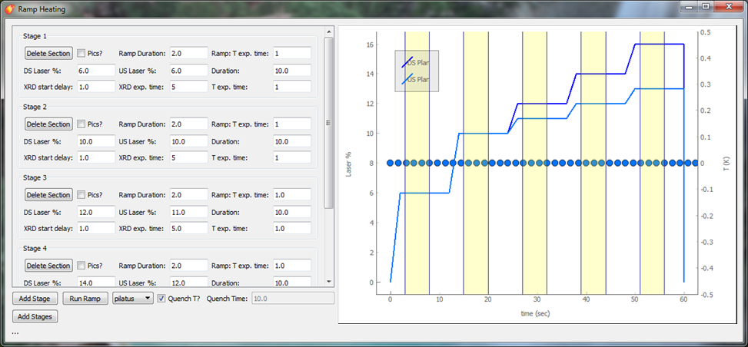
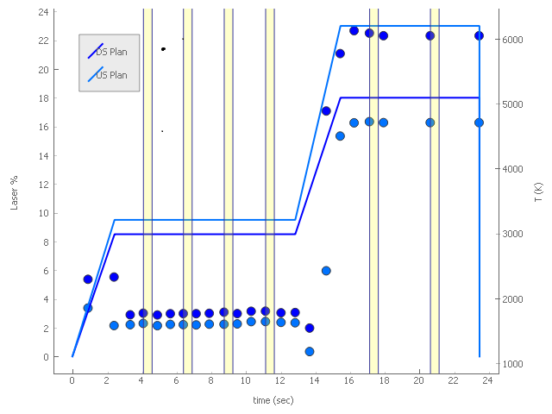
Multi-level ramp laser heating & XRD
Eran Greenberg, GSECARS
Notes:
Logfile can be opened offline with the LogFile software.
The logfile is also saved in a format easily imported as a spreadsheet.
It is possible to decide which PVs are recorder (and whether they are recorder at the start of collection (black) or at the end (blue).

Slide 16
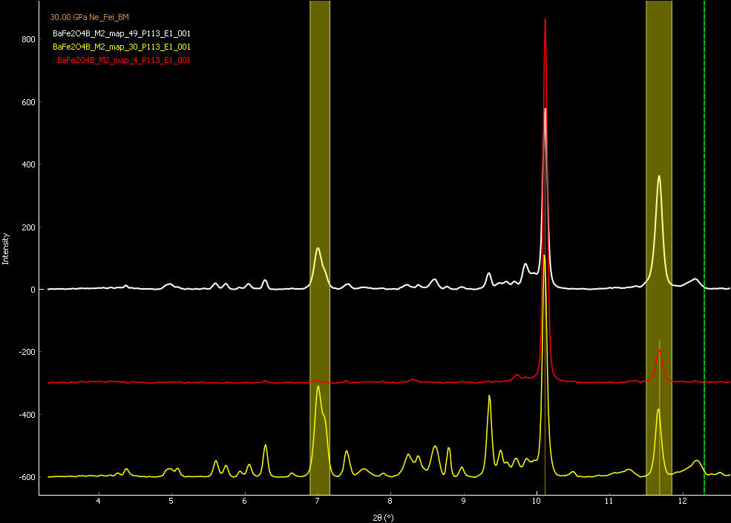
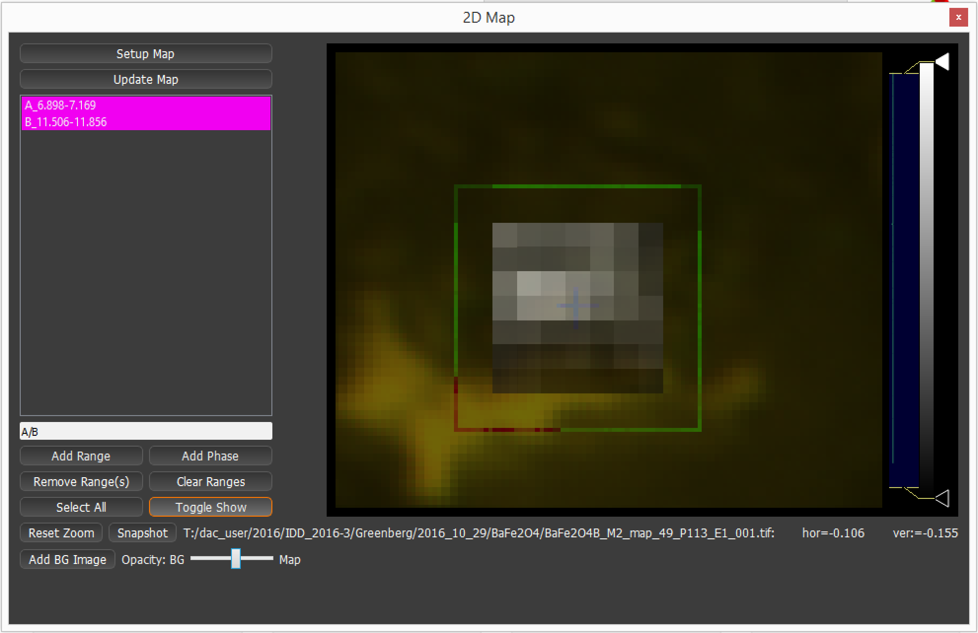
2D-XRD map analysis

Slide 17
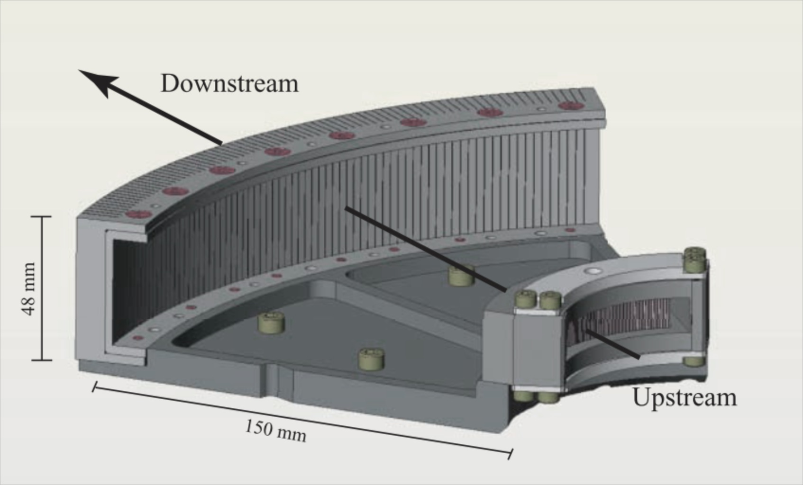
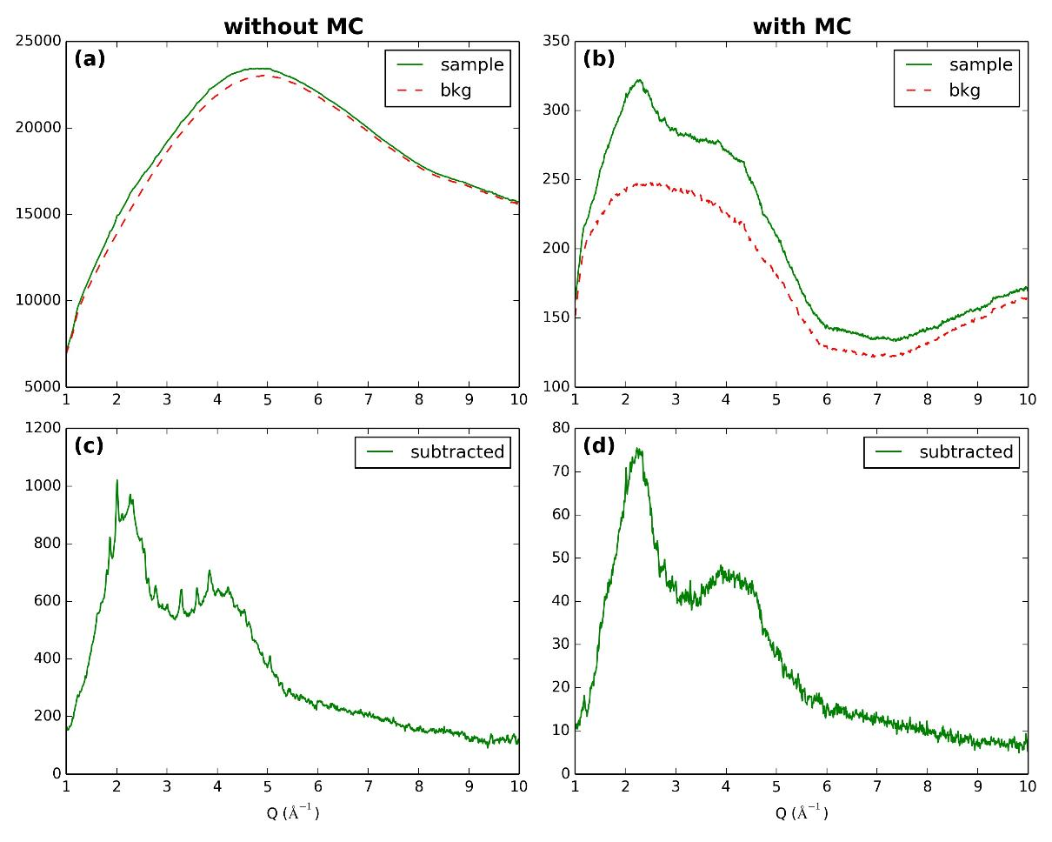
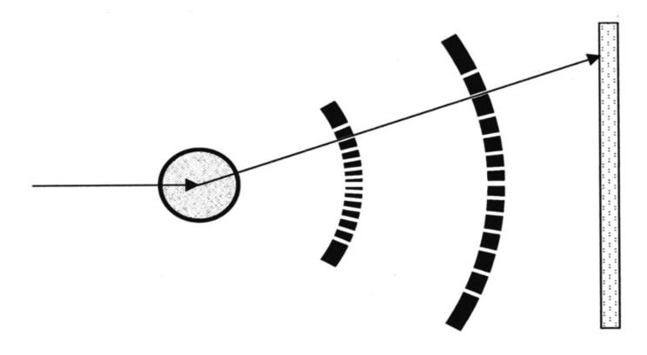
Multichannel Collimator
Comparison between measurements of Mg₂SiO₄ sample in a Diamond Anvil Cell with and without Multichannel Collimator (MCS).
Detector
Sample
X-ray beam
MC
The upstream block is composed of 75 slits of 50 µm positioned at a distance of 50 mm from the sample. The downstream block is composed of 75 slits of 200 µm positioned at 200 mm
Notes:
One of the central aspects for obtaining high quality structural information of disordered materials by X-ray diffraction is perfect background subtraction. This is particularly difficult when employing high-pressure vessels, such as diamond anvil cells (DAC) and Paris-Edinburgh large volume presses (PEP). Their background contribution is very high compared to the low diffuse scattering signal of the sample, especially at high diffraction angles, and furthermore the background is changing during compression and decompression.
In order to overcome this challenge we have successfully installed a multichannel collimator (MCC) for the DAC setup at the GSECARS 13-IDD beamline, APS

Slide 18
PHYSICAL REVIEW B 95, 140101(R) (2017)
Stable high-pressure phases in the H-S system determined by chemically
reacting hydrogen and sulfur
Alexander F. Goncharov, Sergey S. Lobanov, Vitali B. Prakapenka, and Eran Greenberg
Theoretically predicted Cccm and Im¯3m H3S to be the reaction products at 50 and 140 GPa, respectively. Im¯3mH3S is a stable crystalline phase above 140 GPa and it transforms to R3mH3S on pressure release below 140 GPa.
Pilatus CdTe detector
XRD patterns of Im¯3m H3S directly synthesized from H2 and S. We suggest that the superconducting properties of the directly synthesized H3 S should be examined as such a prepared material has a much better crystallinity compared to that obtained by H2 S decomposition

